Slide 1
Automation Summit
A User Conference
Las Vegas, NV, June 22-25, 2015

Slide 2
2015 Automation Summit
Title
Upgrading Legacy Control Equipment and Software to TIA Portal and WinCC
Track
Best Practices & Novel Approaches
Presenter
Robert “Bobby” Brignac
Company
Braeden Engineering and Consulting
Connect
Connect Event badge ID (use this # to connect with me): S2Q
Session #
1.5

Slide 3
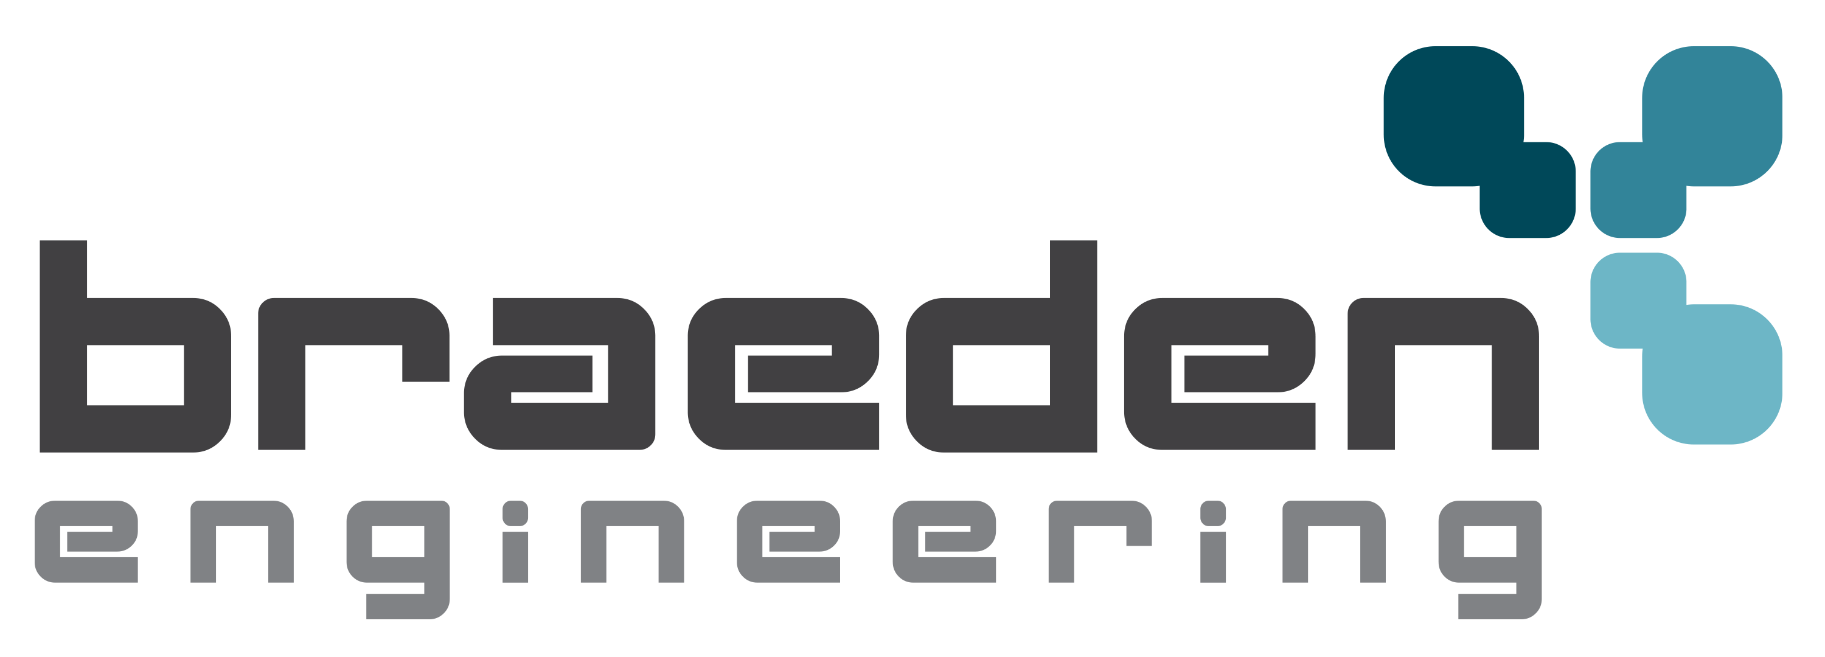

Company Introduction/Overview
  21 employees
  Lafayette LA; Broussard, LA; Houston, TX
  Industrial, Oil and Gas Offshore / Onshore / Subsea
  Services include Engineering and Design, Consulting and Project Management,
  Portable testing and calibration systems, Subsea Drilling Riser Management Systems, Tidal Power systems, Control Systems and SCADA

Slide 4
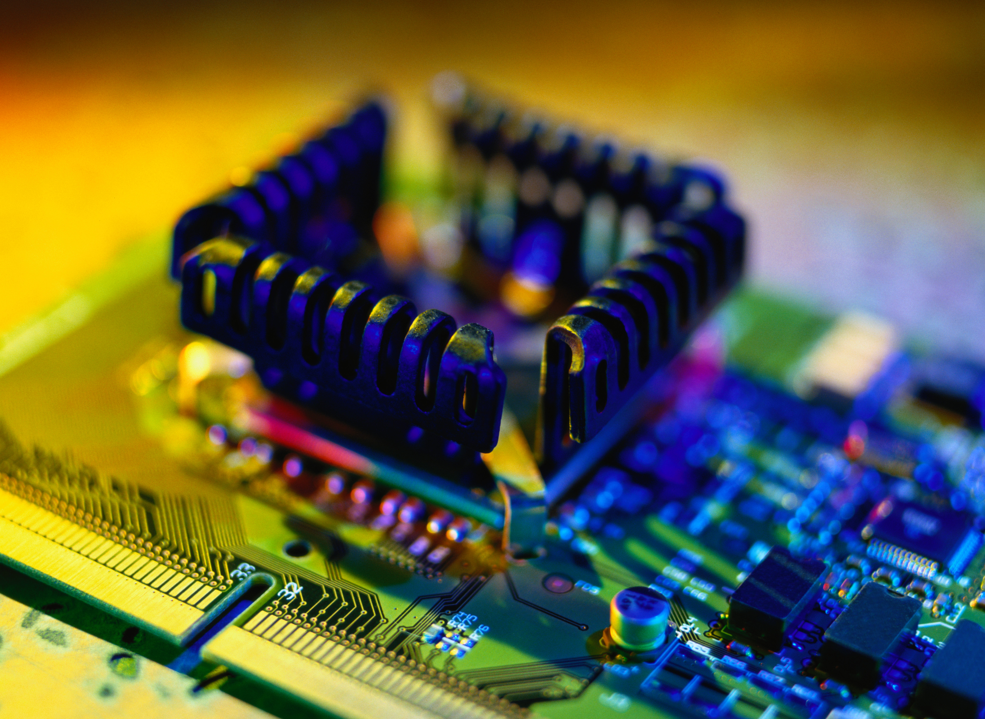
Bio Slide – Robert “Bobby” Brignac, PE
Senior Controls / Electrical Engineer
Professional Engineer with a Bachelor’s Degree in Electrical Engineering from the University of Louisiana at Lafayette (ULL)
Research and Development for Energy Sector
Offshore/Onshore/Subsea Oil and Gas
Hazardous Area Design and Compliance, COMPEx
Drilling Instrumentation and Controls Product Design/R&D
Blowout Preventer (BOP) and Diverter Controls, Subsea and Surface

Slide 5
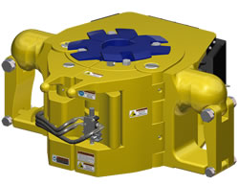
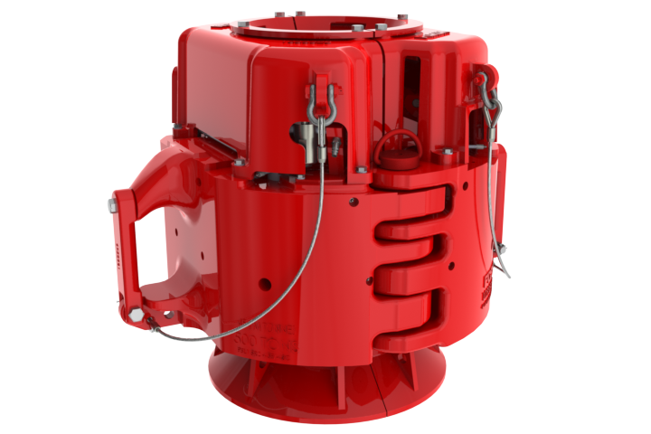
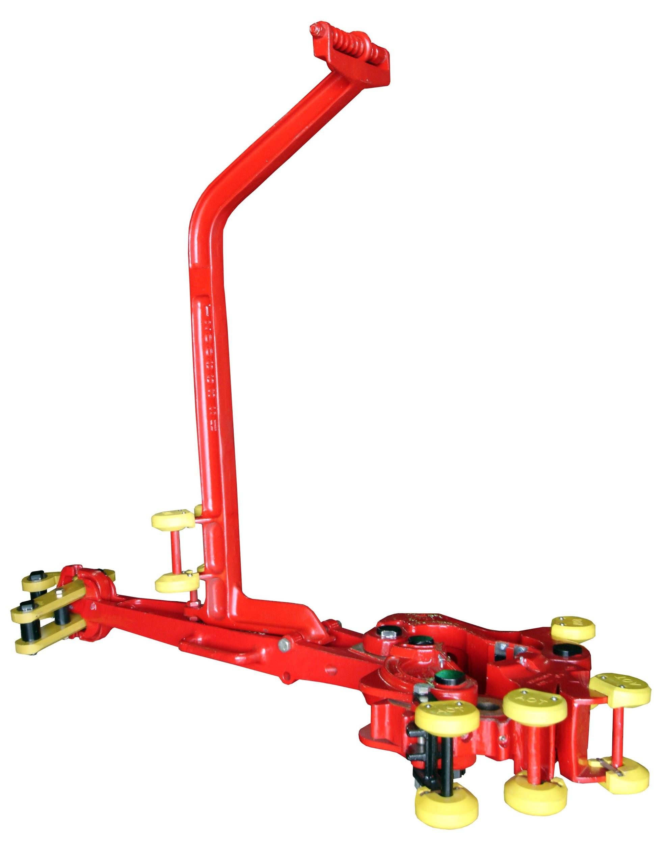

Overview of the Existing System
OEM Manufacturer of tubular handling equipment for drilling applications
American Petroleum Institute (API) requires testing of equipment to specific guidelines and standards
Prove load rating of parts with test charts
Existing system utilizes three separate testing systems for various parts

Slide 6
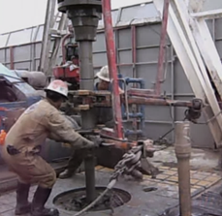
Drilling Tong Testing System
Torque tests drilling pipe tongs
PC Station
Excel based charting and reports
TONG TEST SYSTEM
No live trending
Serial communication to Omega panel meter
Cylinder/arm for applying torque
No automatic control of force
Mid-sized HPU (hydraulic pressure unit)

Slide 7
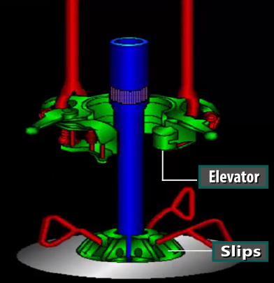
150 Ton Drilling Elevator Press
150 TON ELEVATOR PRESS
Excel based charting and reports
No automatic control of force
Load tests pipe elevators, bails, spiders and slips to 150 tons
No live trending
Smaller sized HPU
PC Station
Serial communication to Omega panel meter
Two small cylinders to apply force
Load tests pipe elevators, bails, spiders and slips to 150 ton

Slide 8
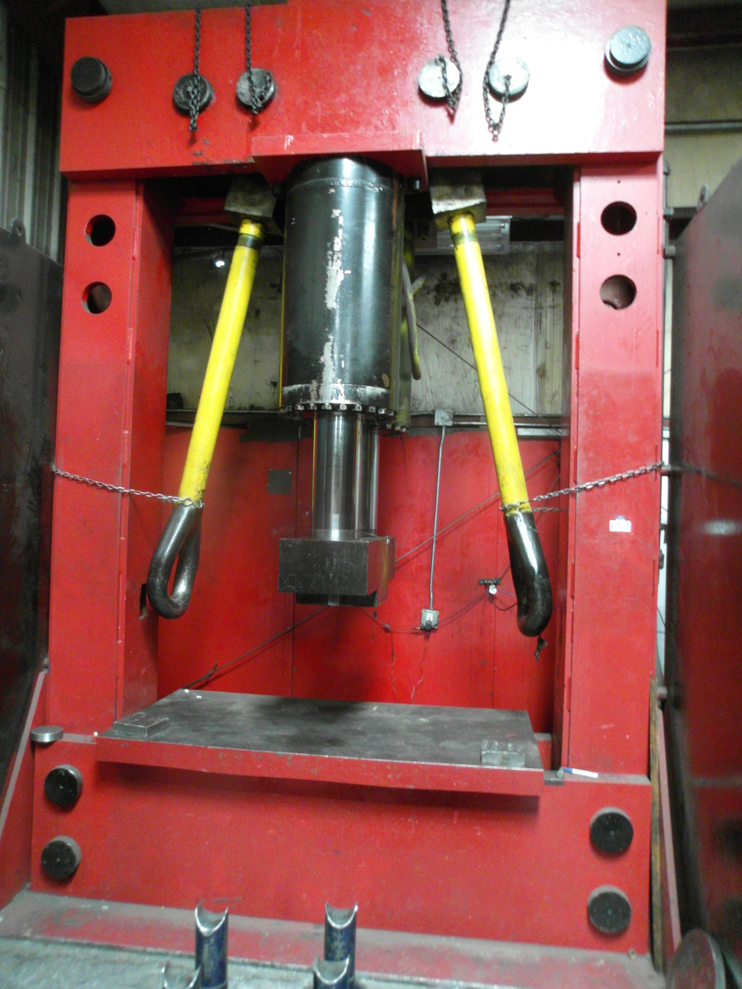
1000 Ton Drilling Elevator Press
1000 TON ELEVATOR PRESS
No live trending
Large HPU
Load tests and pipe elevators, bails, spiders and slips to 1000 tons
Serial communications to IDEC PLC
Axial piston pump with electronic control
PC Station with excel based charting and reports
Automatic control of force via IDEC PLC
30HP motor;
Oil cooler / radiator

Slide 9
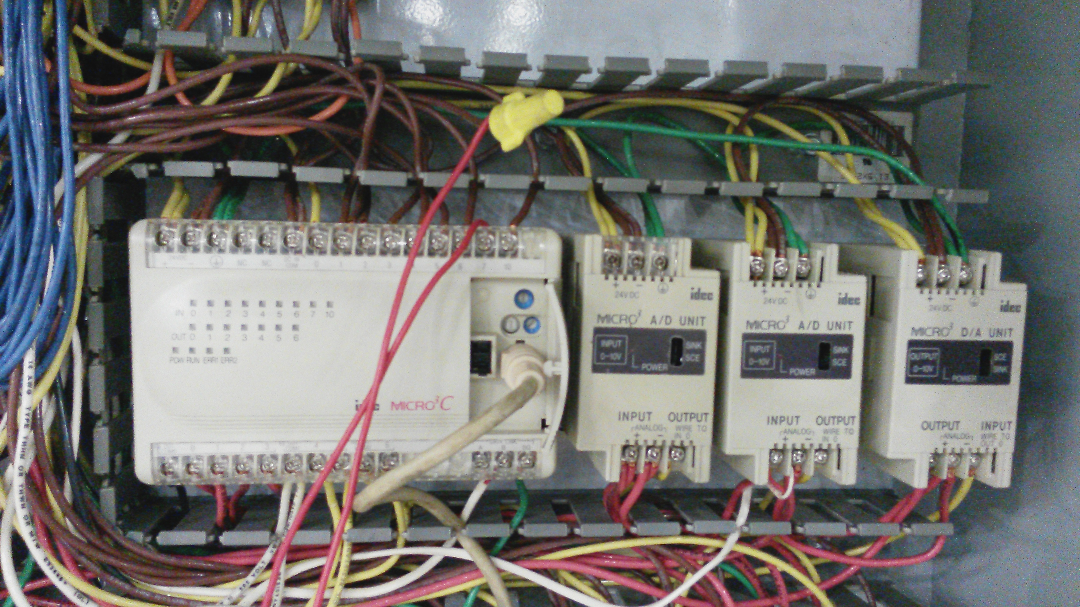
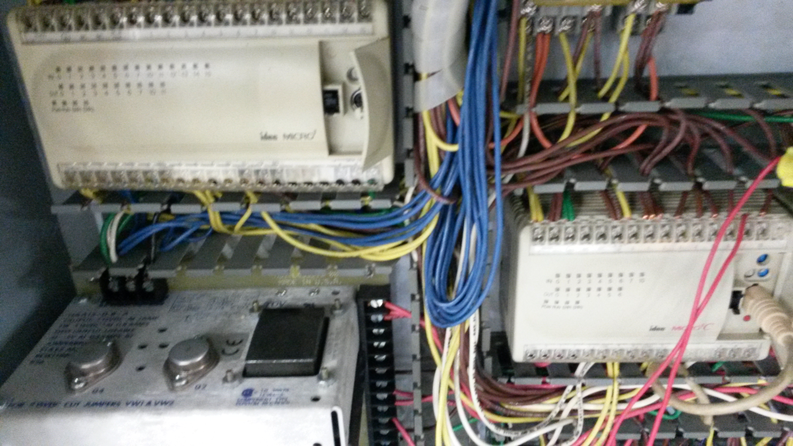
Reasons for the Upgrade
Testing system designed about 20 years ago
Antiquated and obsolete technology
Customer experiencing constant equipment failure issues when testing.
Random load loss on chart
Downtime affecting production
No wiring diagrams
No PLC program
Safety and Efficiency improvements
Upgrades, troubleshooting was not possible or difficult

Slide 10

Upgrade - PLC Hardware
Key Features
Limitations
S71200 PLC and I/O modules provided more I/O density and variation in a reduced footprint.
The I/O density allows flexibility for future upgrades or modification needs.
Ease of install and integration allowed for maximum use of existing components to reduce costs.
TIA Portal was extremely user friendly
PID blocks were easy to use
WinCC communication
Auto-tune of PID
Desire to maximize use of antiquated, legacy equipment

Slide 11

Upgrade – WinCC Software
Key Features
Limitations
WinCC V7.0 did not work with S71200 PLC
Auto generation of PDF reports
WinCC was extremely user friendly
Very powerful software package
Update to WinCC 7.2 made a more stable runtime
C and VBScript compiler/editor
  Organization of all functions for multiple developers
  Auto print PDFs using PDF creator
  Multiple chart creation
  File operations
  Database operations
  Fast processing of load values

Slide 12

Issues Encountered
Conflicting Information from customer
Lack of knowledge on the system from the customer
Proportional controller obsolete and faulty
Faulty communications from panel meters
Pressure transmitter mounted directly on output of the pump
Hydraulic lines to the cylinders were hosed inefficiently
Inadequate hardware support of hydraulics
Fluid temperature of pump, unstable control at low temps
Fluid type
Unrepairable failure of existing Tong Test Machine PC fast-tracked initial deployment
Facility move just before the project
Little Upgrade Time

Slide 13
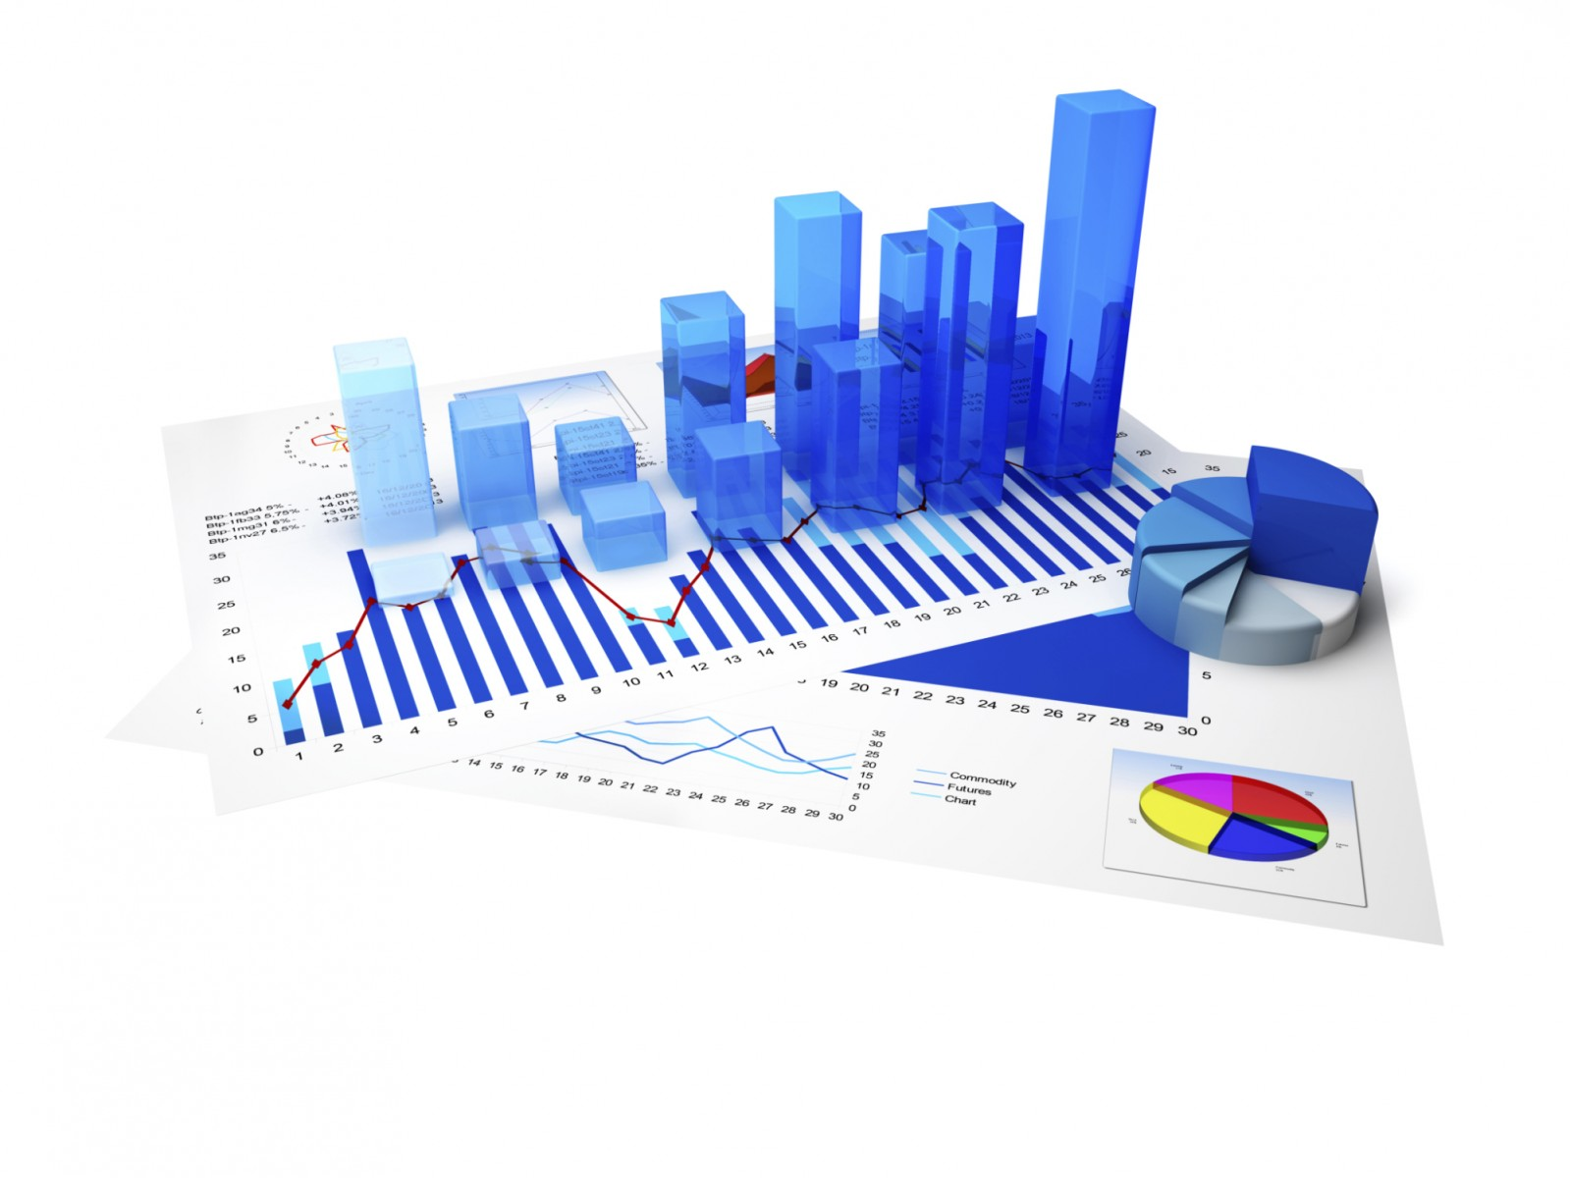
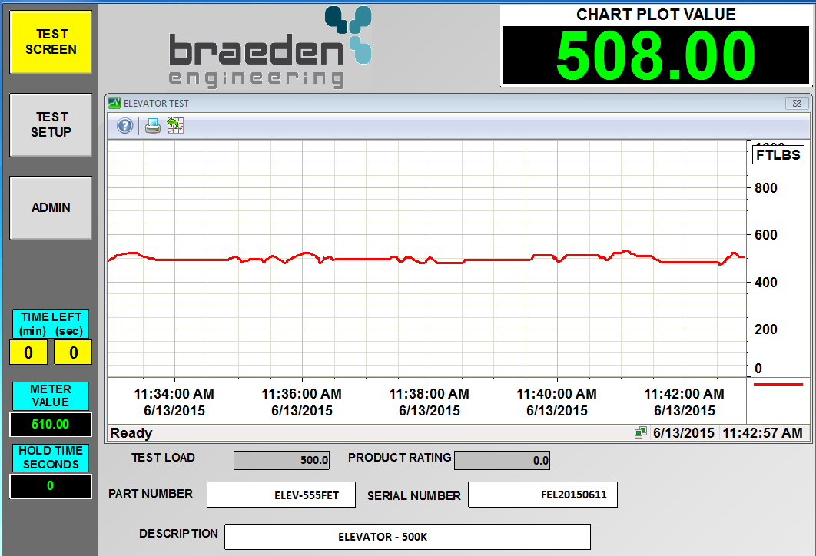
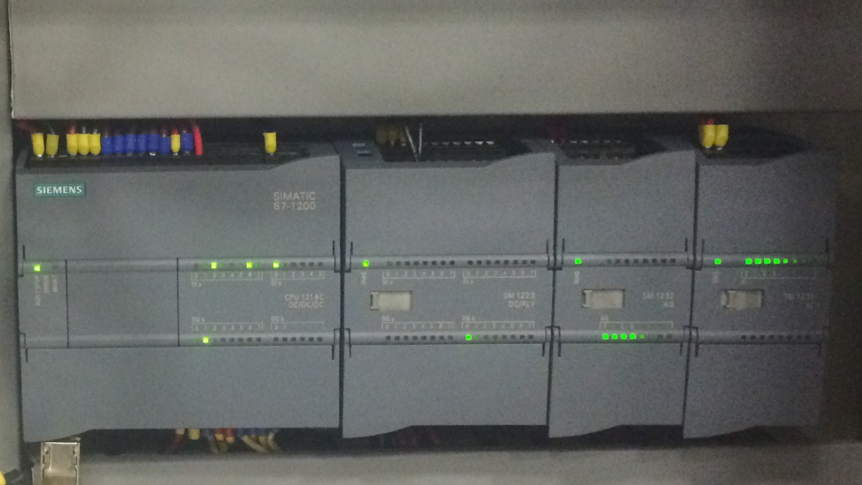
Results of Project
  Far less downtime
  Single version of software for all tests
  Non-linear calibration for 1000 ton press
  No errors during tests due to PLC equipment or software
  Better reporting to the end user
More reliable and robust system
More efficient test processes
  Auto-shutdown on overload and under-load conditions
  Archival of failed tests
  User friendly operation
  Error correction and prevention
Tester verification
Quicker test times

Slide 14

If I could do it all over again…
Investigate connecting the new system at the same time as the old system
  Reference Siemens white paper on migrating legacy equipment (LINK)
Look into using TIA Portal for WinCC Advanced in lieu of WinCC 7.2
Additional testing of legacy system
Additional documentation
Investigate the hydraulics issues further and pressure client into fixing them

Slide 15

Add automatic control to the Tong and 150 ton press
Non-linear calibration for all machines
Remove panel meters and replace with S71200
New control panel for 1000 ton press
Design a 2000 ton press machine

Slide 16

Before we wrap up…
Name: | Robert “Bobby” Brignac
Company Name: | Braeden Engineering and Consulting
Email: | bbrignac@braedenengr.com
Phone: | 337.347.5636 x703 Direct 337.257.3584 Mobile
Connect Event badge ID (use this # to connect with me): | S2Q
Session #: | 1.5

Slide 17

QUESTIONS
usa.siemens.com/summit

